Slide 1
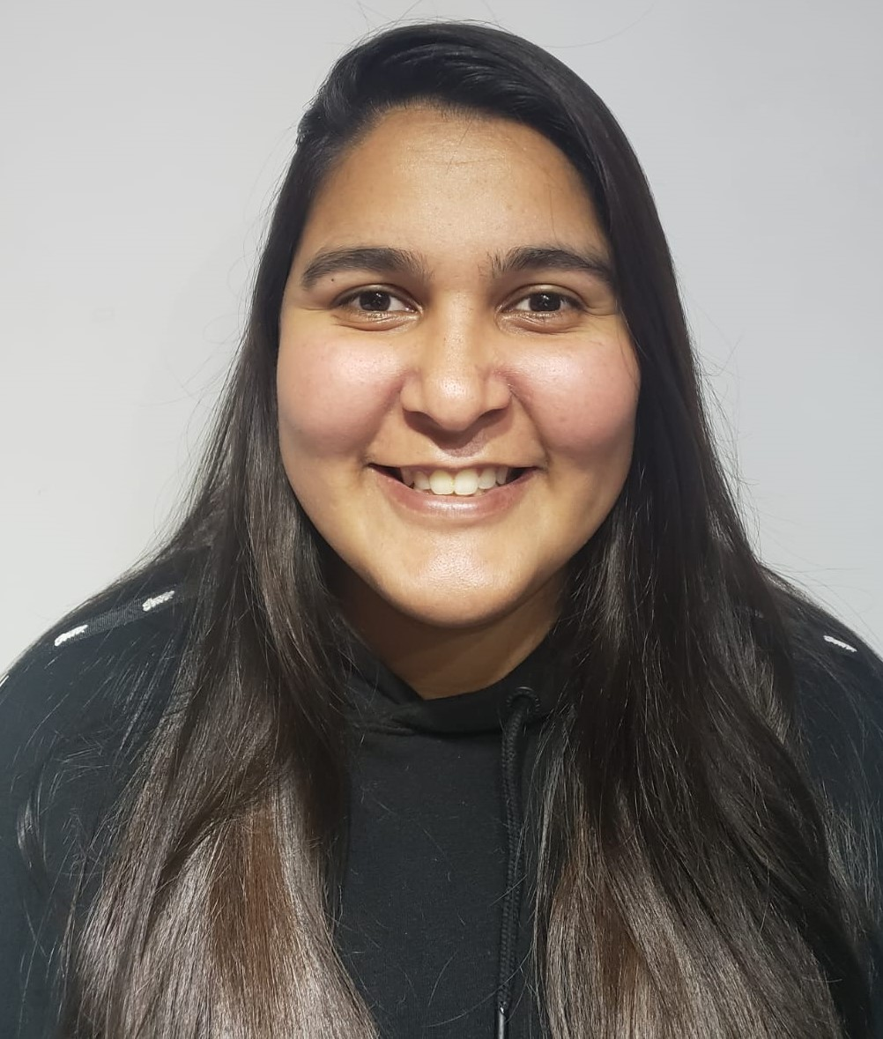
Josmary Salazar
Data Eng, Mgmt & Governance Specialist
Data & AI > Data Eng, Mgmt & Governance
j.salazar.perez@accenture.com
Buenos Aires, Argentina
Data Engineering and Data Governance Specialist with over nine years of experience in backend development, ETL process design, system integrations, and end‑to‑end support in Microsoft and Azure environments. Experienced in resolving complex technical issues, automating workflows, and optimizing solutions within development teams.
Currently undergoing a formal re‑skilling process focused on Generative AI and Agentic AI, gaining knowledge in agent architectures, reasoning workflows, RAG, knowledge‑graph approaches, and advanced techniques to integrate AI into software processes. My goal is to combine a strong foundation in data engineering with new AI capabilities to contribute to scalable, efficient, and business‑aligned solutions.
DEVIN AI Proof of Concept
Planned and structured the activities and milestones of the DEVIN POC.
Provided support to participants during meetings and through offline assistance.
Executed DEVIN runs with and without participants to complete assigned use cases.
Processed and analyzed POC results to identify performance, gaps, and improvement opportunities.
Prepared presentations summarizing outcomes and proposing next steps for DEVIN adoption within the business.
Computational Governance(2025 – 2025)
Development of AI ethics and governance policies.
Definition of guidelines for the responsible use of data and models.
Identification and evaluation of potential automations using existing tools.
Logistic Planning Optimization (2019 – 2024)
Worked across multiple phases of the project, progressing from software development to broader responsibilities in planning, analysis, and technical decision‑making.
Developed new modules and refactored, improved, and fixed existing components using .NET Framework, C#, JavaScript, Vue.js, and GAPP framework.
Built integrations for data exchange using C# web APIs.
Estimated and analyzed requirements for new functionalities and upcoming development phases.
Planned and estimated sprints using Microsoft Project, supporting the coordination of different development stages.
Attended client meetings to gather requirements for new modules and integrations.
Analyzed complex production issues, identified application errors, and proposed solutions.
Evaluated and recommended Azure technologies (WebJobs, Azure Functions, APIs) for specific needs.
Monitored development team tasks, provided support to ensure completion, and performed deployments and configurations through Azure DevOps.
(outside Accenture)​
Senior Software Developer .NET (2019)
Software Developer .NET (2015-2019)
ETL, .NET/C#, SQL, MongoDB, CI/CD, Git, automation, Power BI (Beginner).
Azure AI Foundry, CI/CD, Git and DevOps practices.
Documentation and cross‑team coordination.
Foundations in Generative AI, RAG, reasoning workflows and agent‑based architectures
Inventory
Oil & Gas
CERTIFICATIONS

